Slide 1
Chapter 20: Special Purpose Diodes (Part 2)
Optical Diodes

Slide 2
Optical Diodes
This part of the chapter covers the following 2 common optical diodes :
Light Emitting Diode (LED)
Photodiode

Slide 3
Objectives (Part 2)
After completing Part 2 of this chapter, you will be able to:
Understand and explain the characteristics and operation of an LED
Know the semiconductor materials used for different coloured LEDs
Know the common applications of LEDs
Understand and explain the characteristic and operation of a photodiode
Know the relationship between photodiode reverse current and irradiance
Know the common applications of photodiodes

Slide 4
Demonstration of LED
How to make LED brightness variable?
LED still lights up but becomes Dimmer
LED Lights up
I_{F}
Current Flows
1kΩ
330Ω
Open
Use Variable Resistor (Trimpot)
What if we increase R to 1kΩ?
Close
LED are typically RED in colour. What other colours of LEDs are available?
5V

Slide 5
LED
Special diode that emits light when forward biased
When forward-biased, electrons cross the p-n junction recombine with holes
These recombining electrons release energy in the form of heat (a little) and light (mostly)
This process is called electroluminescence.
Cathode
LED Symbol
Anode

Slide 6
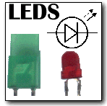
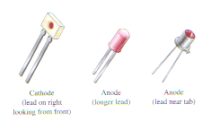
LED
Different impurities are added during doping process to obtain different coloured light
LEDs may also emit light in the invisible part of the colour spectrum (infrared)
Typical LEDs

Slide 7
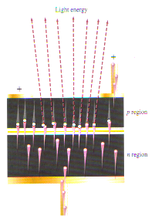
LED
Light energy
Large exposed area here permits visible light to be emitted to the outside world
+
+
p region
n region

Slide 8
LED – Material and Colour
LED is made of either
Gallium Arsenide (GaAs) – Infrared light
Gallium Arsenide Phosphide (GaAsP) – either Red or Yellow light
Gallium Phosphide (GaP) – either Red or Green light.
Red is the most common LED colour
LED producing Blue light also available
Si and Ge are not used because they produce heat rather than light

Slide 9
LED Brightness
Amount of power output translated into light in an LED is directly proportional to the forward current, I_{F}.
Light output
Forward current
This means that Brightness of LED depends on I_{F}
I_{F} in an LED circuit is typically controlled by the resistance present in the circuit
Note, however, that too high a I_{F} may cause LED to be damaged

Slide 10
LED - Forward and Breakdown Voltages
LED emits light when there is sufficient forward current.
Forward voltage across an LED is greater than for diode (typically 1.2 to 3.2 V)
Reverse breakdown is also much less compared to junction diode (typically 3 to 10V)
+V_{F} -
I_{F}
R
+V_{BIAS} -

Slide 11
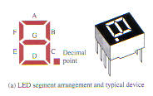
7-Segment Displays
LEDs can be used as Indicator Lamps or Warning Lights
When arranged in the figure “8” they can be used to display numbers 0 - 9
This arrangement of LED is called the 7-segment display

Slide 12
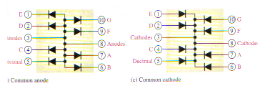
7-Segment Displays
Each segment has a name “a” – “g”
7-segment displays come in either common anode or common cathode arrangement
E
D
E
D
G
F
G
F
Cathode
Anode
Anode
Cathode
C
Dec
C
Dec
A
B
A
B
Common Anode
Common Cathode

Slide 13
Photodiode
A special diode whose reverse biased current depends on amount of light shining on it
When dark, behaves like a normal diode and allows only very little current through
This current is the reverse biased leakage current, also called dark current

Slide 14
Photodiode
When lighted, property changes and allows much higher current through it.
Current is proportional to light intensity
Small transparent window present to allow light to shine in

Slide 15
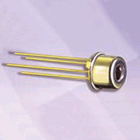
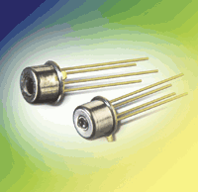
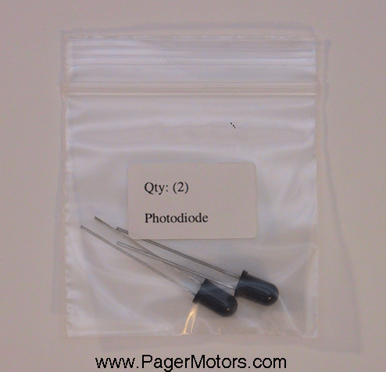
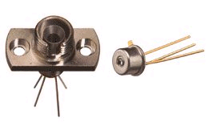
Photodiode
Typical Photodiode
Symbol
λ

Slide 16
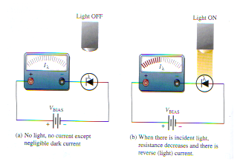
Photodiode
LIGHT OFF
LIGHT ON

Slide 17
Photodiode
Amount of reverse current (I_{λ}) depends on amount of light irradiating the photodiode
λ
Reverse Current (I )
I_{λ}
- V_{R} +
Reverse-bias operation
Irradiance, H

Slide 18
Photodiode
Sensitivity of different photodiodes may differ
V-I characteristic of photodiode is represented using graphs with light intensity as a 3rd variable
Intensity of light measured in mW/cm² or in lumens/m ² (lux)

Slide 19
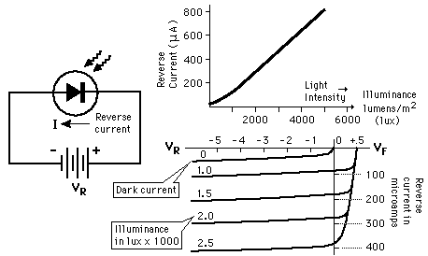
From these graphs, resistance of photodiode at different luminance can be calculated

Slide 20
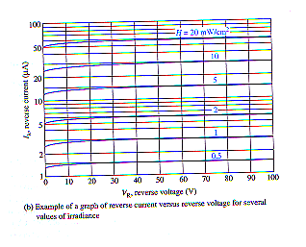
From graph,
When irradiance = 0.5 mW/cm², and reverse bias voltage V_{R}=10V, reverse current=1.4μA.
Device Resistance
H = 20mW/cm²
0.5mW/cm²
At 20 mW/cm², V_{R} = 10 V,
current = 55μA,
Photodiode can be used as a variable-resistance device controlled by light-intensity

Slide 21
Applications of Optical Diodes

Slide 22
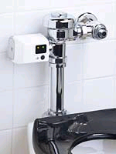
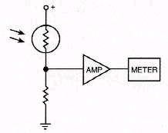
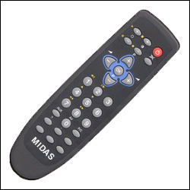
Consumer Devices
Auto Flush
Photodiode
Ambient Light Detector
Remote Control

Slide 23
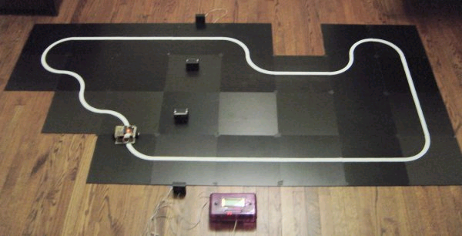
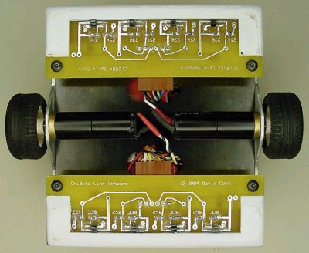
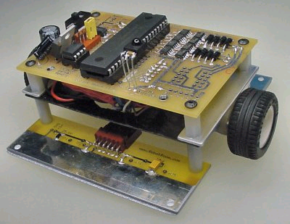
Path Tracking
An LED-photodiode pair for path tracking

Slide 24
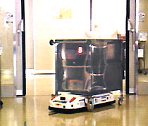
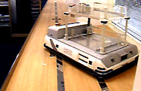
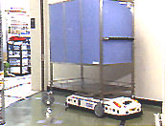
Automated Guided Vehicle
Path Tracking and Obstacle Avoidance in AGV

Slide 25
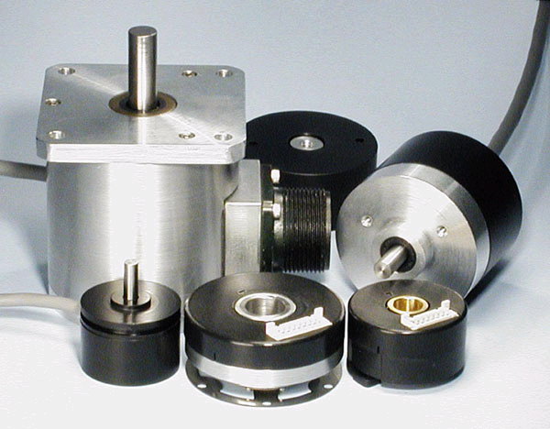
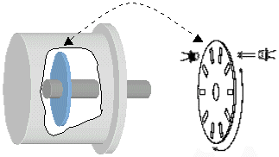
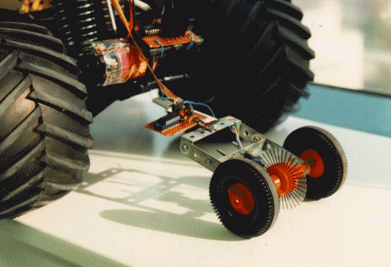
Optical Encoders
Measuring Motor Speed and Position in Optical Encoders

Slide 26
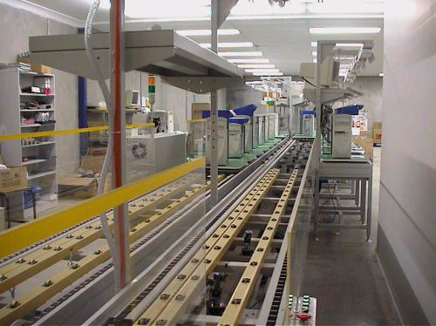
Item Counter
Counting Items Passing Through a Production Line

Slide 27
Simple Colour Sensor
LEDs and Photodiodes can also be used to create a primitive colour sensor.
How do you think this can be done?
Use photodiodes with R, G and B filters

Slide 28
Summary
Light Emitting Diode (LED)
LEDs are made from special semiconductor materials such as Gallium Arsenide (GaAs) and Gallium Arsenide Phosphide (GaAsP).
A variety of LEDs emitting different coloured lights are available.
For an LED to emit light, sufficient forward bias voltage (typically about 2V) has to be applied.
Applications of LED include lamp indicators and read-out displays.

Slide 29
Summary
PHOTODiode
A photodiode is normally operated in the reverse biased mode. A dc voltage source is used to provide the reverse bias.
The photodiode resistance decreases in response to increased light intensity. A significant reverse current flows through the photodiode as a result of the drop in photodiode resistance.

Slide 30
End of Chapter 20

